Slide 1
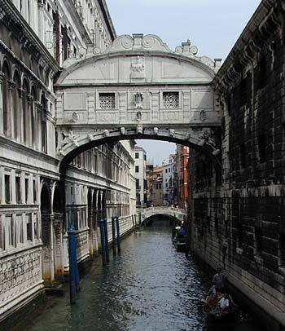
Living In Venice
A Study of Quality of Life in Venice
Stephanie Miskell
Tobin McGee
Josh Luther
Jenny Lund

Slide 2

Big Picture

Slide 3
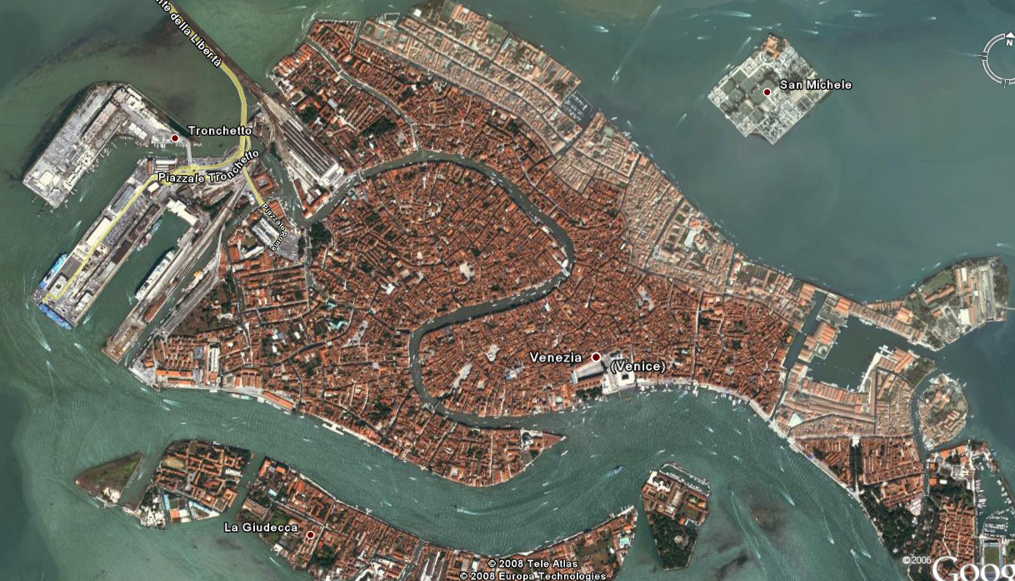
Local Picture

Slide 4
Gap

Slide 5
Our mission is to investigate the determining factors of the quality of life of Venetians and to compile our findings into an accessible form for future projects
To compile all relevant information pertaining to quality of life into a single form
To predict future trends of Venice and predict possible future situations
To investigate the Venetians' opinions on the quality of life in Venice
To assess the actions that the Venetian government has taken

Slide 6
Quality of Living
Cost of Living
Tourism
Crime
Housing
Economy/Finance
Job Market
Transportation
Public Service

Slide 7
Motion Chart with Population Prediction

Slide 8
Opinions

Slide 9
Government Action

Slide 10

Italian (Cittia’ di Venezia Website)
Information about Venice (Historical Center)
Most of the data about Venice is about tides

Slide 11
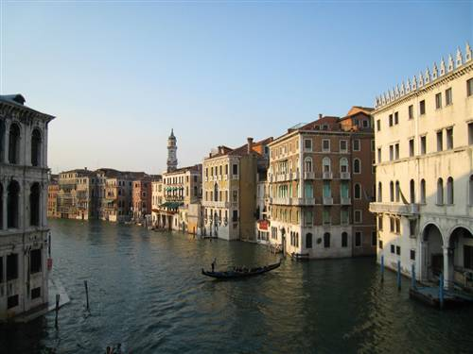
Compile Quality of Life Data
Continually Update Living in Venice wiki page
Revise and update proposal

