Slide 1
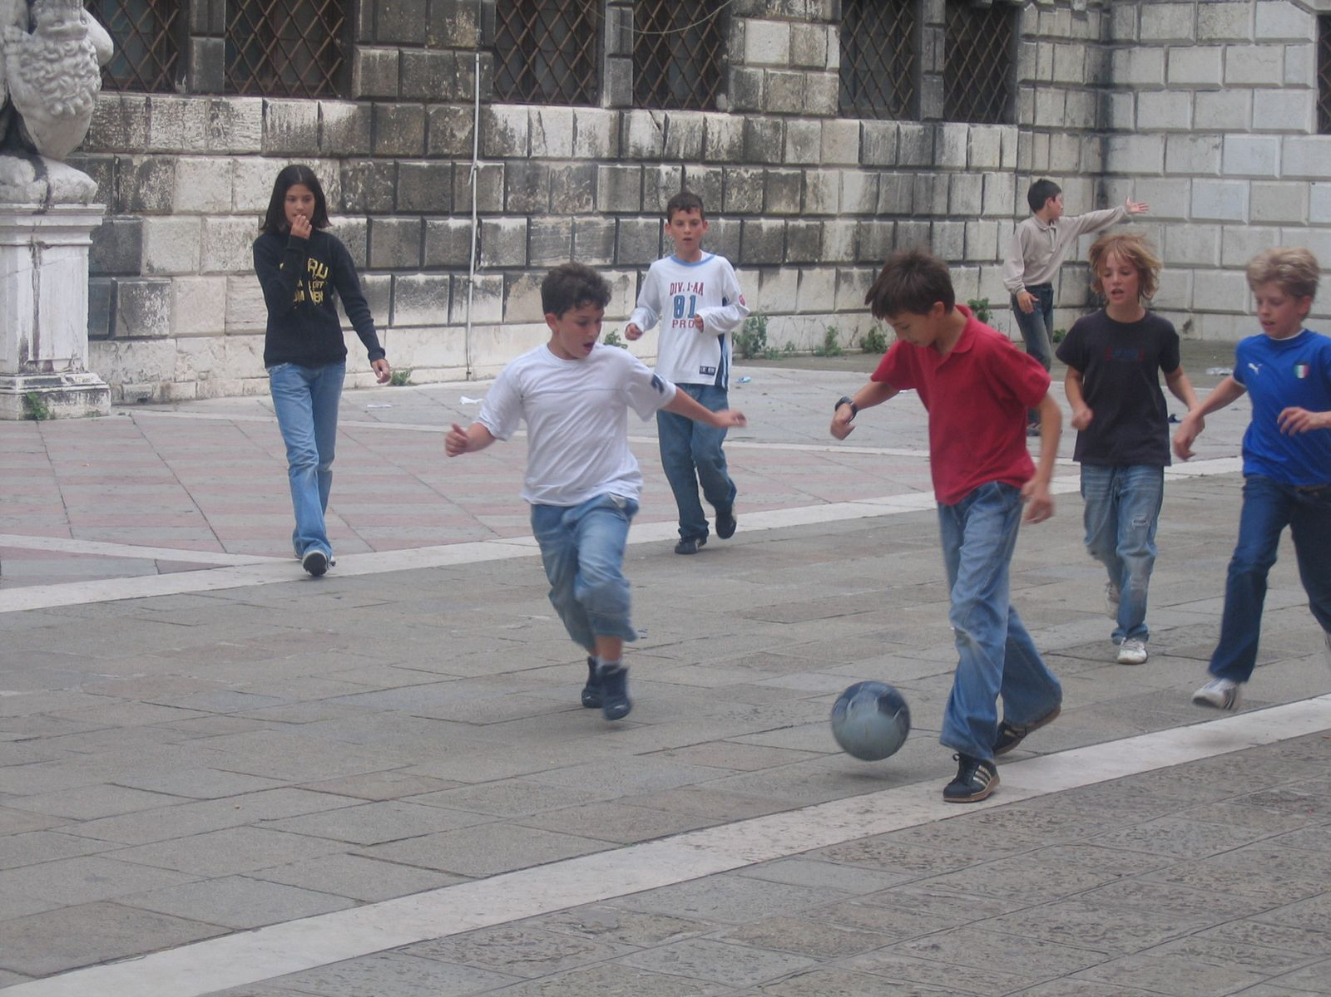
Preserving the Youth Culture in Venice
Meggan Birmingham
Akhil Kejriwal
Julie Marquis
Pedriant Pena
Notes:
We all talk to introduce ourselves and our project

Slide 2

ASSOCIAZIONE I GIOVANI VENEZIANI
An association of young people in Venice who are identifying issues and creating programs to help relieve some of these issues.
Due to the outcomes of living in a tourist city youth are struggling to continue living within these areas because of lack of resources
Notes:
Julie

Slide 3
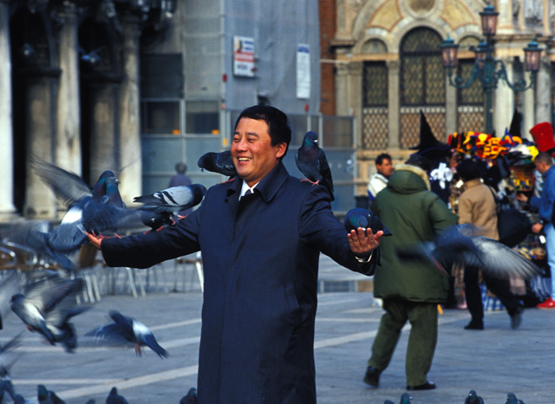
LOCAL ISSUES
Tourism has begun to affect Venice’s way of life
  Second most expensive city in Italy after Rome
  Lack of variety in the job field
    Local stores close to accommodate touristic venues
  Population under 30 decreased from 37.4 % in 1984 to 23.9% in 2004
  Lack of necessary facilities
    Daycares
    Entertainment for the venetian youth
Notes:
Julie

Slide 4
LOCAL ISSUES
Tourism has begun to affect Venice’s way of life
  Second most expensive city in Italy after Rome
  Lack of variety in the job field
    Local stores close to accommodate touristic venues
  Population under 30 decreased from 37.4 % in 1984 to 23.9% in 2004
  Lack of necessary facilities
    Daycares
    Entertainment for the venetian youth
Notes:
Julie (this slide is just to hightlight the second sub-bullet and to prepare for next slide)

Slide 5
LOCAL ISSUES
    Local stores close to accommodate touristic venues
Notes:
Julie
(this was taken from an IQP last year and you can see that the local service stores have been decreasing and the abandoned buildings and closed shops have increased)

Slide 6
LOCAL ISSUES
Tourism has begun to affect Venice’s way of life
  Second most expensive city in Italy after Rome
  Lack of variety in the job field
    Local stores close to accommodate touristic venues
  Population under 30 decreased from 37.4 % in 1984 to 23.9% in 2004
  Lack of necessary facilities
    Daycares
    Entertainment for the venetian youth
Notes:
Meggan (this is prepartation for next slide)

Slide 7
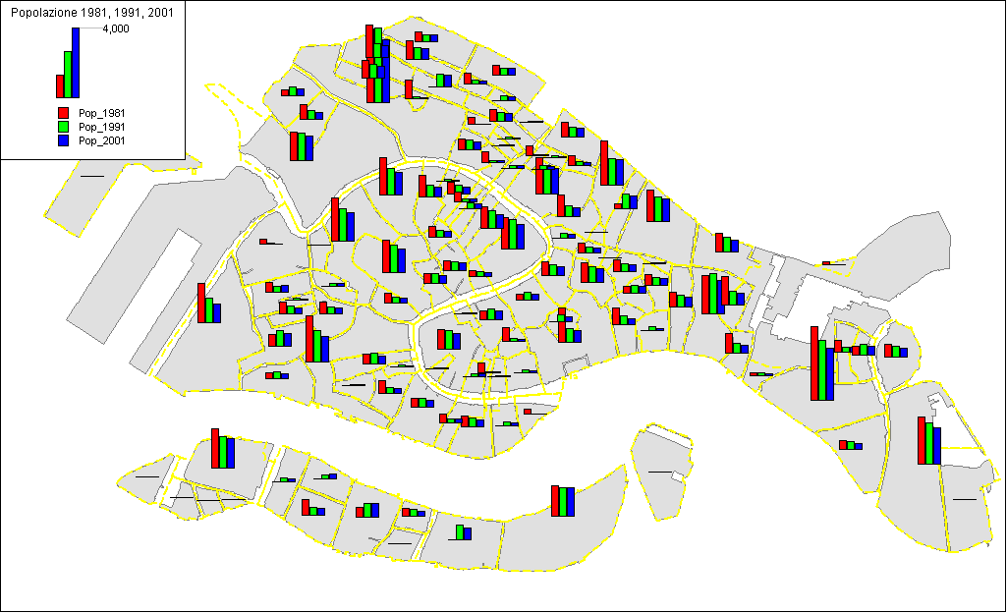
LOCAL ISSUES
  Population under 30 decreased from 37.4 % in 1984 to 23.9% in 2004
Notes:
Meggan (this is the from an IQP from last year and you can see the decline in population) Tell how the red is the pop in 1981 and the blue is current, and even tho this is the whole population of Venice, the biggest percentage of population decrease was people under 30 years old

Slide 8

MISSION STATEMENT
The goal of this project is to assess the opportunities and challenges of the Venetian youth lifestyle.
Notes:
Meggan

Slide 9
OBJECTIVES
To discover and reconstruct the emerging youth trends in Venice
To understand common views and opinions regarding the Venetian youth lifestyle
To assess the opportunities of the Venetian youth
To assess the challenges of the Venetian youth
To document alternatives for facilities and programs
Notes:
Pepi

Slide 10
OBJECTIVES
To discover and reconstruct the emerging youth trends in Venice
To understand common views and opinions regarding the Venetian youth lifestyle
To assess the opportunities of the Venetian youth
To assess the challenges of the Venetian youth
To document alternatives for facilities and programs
Notes:
Meggan

Slide 11
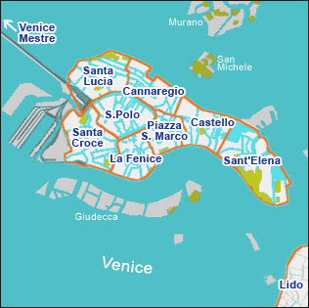

OBJECTIVE 1
To discover and reconstruct the emerging youth trends in Venice
  To collect and compile data sets for demographics through the years
  To figure out reason behind Italian Immigrant trends vs. Venetian Emigrant trends
Notes:
Meggan – Say how we will do this. Methodology stuff

Slide 12
OBJECTIVES
To discover and reconstruct the emerging youth trends in Venice
To understand common views and opinions regarding the Venetian youth lifestyle
To assess the opportunities of the Venetian youth
To assess the challenges of the Venetian youth
To document alternatives for facilities and programs
Notes:
Akhil

Slide 13
OBJECTIVE 2
To understand common views and opinions regarding the Venetian youth lifestyle
  To create a record of opinions on available opportunities needed by venetian youth
    Collect data from scholars, native Venetians etc as well as the youth
Notes:
Akhil - Say how we will do this. Methodology stuff

Slide 14
OBJECTIVES
To discover and reconstruct the emerging youth trends in Venice
To understand common views and opinions regarding the Venetian youth lifestyle
To assess the opportunities of the Venetian youth
To assess the challenges of the Venetian youth
To document alternatives for facilities and programs
Notes:
Meggan

Slide 15
OBJECTIVE 3
To assess the opportunities of the Venetian youth
  To identify and record existing ‘youth’ facilities and points of interest throughout the city of Venice
Notes:
Meggan - Say how we will do this. Methodology stuff

Slide 16
OBJECTIVES
To discover and reconstruct the emerging youth trends in Venice
To understand common views and opinions regarding the Venetian youth lifestyle
To assess the opportunities of the Venetian youth
To assess the challenges of the Venetian youth
To document alternatives for facilities and programs
Notes:
Pepi

Slide 17
OBJECTIVE 4
To assess the challenges of the Venetian youth
  To identify the most common challenges faced by the Venetian youth
  To identify reasons why the younger Venetians are leaving their native country
Venetian youth
Venetian youth
Notes:
Pepi Say how we will do this. Methodology stuff

Slide 18
OBJECTIVES
To discover and reconstruct the emerging youth trends in Venice
To understand common views and opinions regarding the Venetian youth lifestyle
To assess the opportunities of the Venetian youth
To assess the challenges of the Venetian youth
To document alternatives for facilities and programs
Notes:
Julie

Slide 19
OBJECTIVE 5
To document alternatives for facilities and programs
  To investigate what similar cities have done to regulate this problem
  To find if these alternatives are even desirable
  To establish future trends depending on different plans of action
    Take away existing youth programs
    Leave the situation as is
    Implement our proposed actions
Notes:
Julie Say how we will do this. Methodology stuff

Slide 20

ISSUES & OBSTACLES
Find useful sources
  First year IQP subject
  Not a lot of data on similar cities
Language barrier
Finding efficient method to gather opinion from youth in Venice
Notes:
Akhil

Slide 21
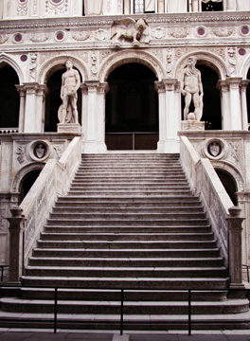
NEXT STEPS
Refine the background and methodology
Continue to obtain information from collaborator, Marco Passi
Final Proposal
Final Presentation
Pack our bags
Notes:
Akhil

Slide 22
CONCLUSION
The Venetian lose of youth could affect future outcomes retaining the native population. So we will continue to collect and refine information on the issue.
Notes:
Akhil

Slide 23
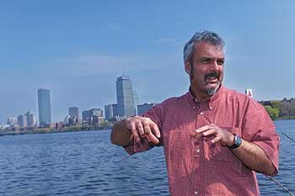
QUESTIONS & COMMENTS

