Slide 1
Adulti Methodology
Interviews
Coding
Word Cloud
Notes:
Josh

Slide 2
Overall Frequency of Interviews
Notes:
This word cloud was generated from the notes of all of the interviews we conducted. In order to simplify the results of the word cloud, we categorized the responses from Venetians into the following categories you see here. This word cloud in particcular is interactive and by mousing over a word, you can see what we identified as the most important demographic breakdown of the people who gave this response. (Expensive, Shop Variety) Josh

Slide 3
Most Frequent Responses
Pro
Community Life 41%
Contro
Cost of Living and Housing 43%
Lack of Shop Variety 13%
Tourism 13%
Pace of Life 15%
Culture 10%
Notes:
Josh

Slide 4
The Venetian lifestyle is treasured by its inhabitants…
Notes:
Josh

Slide 5
Pro
Community Life
Here people are warm and friendly. Venetians are happy to talk if you were to bump into them on the street.
-Retired Venetian, 62
You can walk from your house to work and meet ten people you are friends with and have a conversation with them.
- Local Venetian, 47
Notes:
This word cloud was generated from our responses from people about what they liked about Venice. As you can see, the community life of Venice was the most treasured by its inhabitants. We have a few quotes in particular that we thought illustrated this. Josh

Slide 6
Pro
Pace of Life
It is a different pace of life because there are no cars. You often meet people on the streets. -Historian, 53
It is quiet, you don’t have to hurry from one place to the next. It is an easy way to live.
– Architect , 42
The city of Venice is in a bubble, you think differently here.
- Mestre Resident, 31
Notes:
The second most frequent response we received about what people like about Venice. The residents identified a lifestyle in Venice that they felt was unique. Josh

Slide 7
Pro
Culture
The area near the Peggy Guggenheim is beautiful. The city is aesthetically pleasing.
- 40xVenice Member, 42
You can go around the city and find new things all the time. There are palaces and art everywhere.
- Historian, 53
Notes:
Finally, we also found the many Venetians loved the city simply because of its history and culture. Many Venetians felt like they had inherited a legacy from their ancestors and were quite proud and protective of it. Josh

Slide 8
…but residents expressed concerns for the high cost of living and housing…
Notes:
Tobin

Slide 9
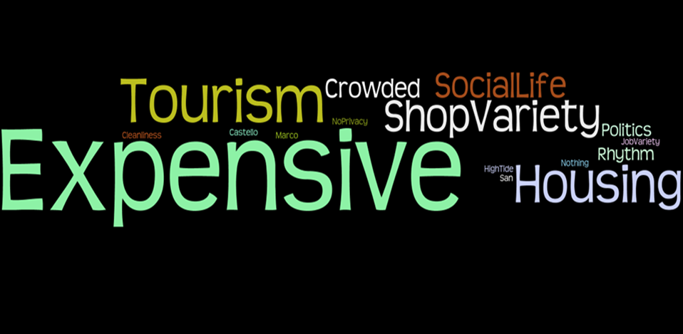
Contro
Cost of Living and Housing
Venice is a question of time and money. If you aren’t concerned with that, Venice is a good place to live.
- Mestre Resident, 31
The cost of life is very expensive. People will go to the mainland to shop because it is cheaper.
– Architect, 42
Housing is only for the rich.
– Waitress, 44
Notes:
This word cloud illustrates our responses to what people disliked the most about Venice. The most frequent answer we received across all age groups and demographics was the cost of living and housing. Tobin

Slide 10
Notes:
Tobin

Slide 11
Contro
Lack of Shop Variety
All our stores are becoming glass and mask shops, pretty soon all we will have will be glass and mask shops. We cant eat glass and masks.
- Bookstore Owner, 35
There has been an influx of tourist shops in the local neighborhoods. They have wiped out the typical Venetian shops and changed the neighborhoods.
-Mother, 32
Notes:
Another topic that was frequently brought up negatively in our interviews was the lack of shop variety in Venice. Many residents felt that the city lacks the stores that are needed to acquire the basic necessities of life at reasonable costs. Tobin
All our stores are becoming glass and mask shops, pretty soon all we will have will be glass and mask shops. We cant eat glass and masks

Slide 12
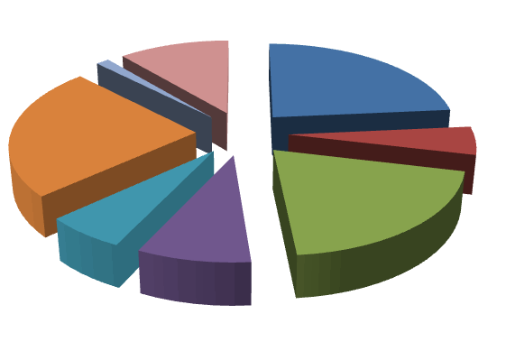
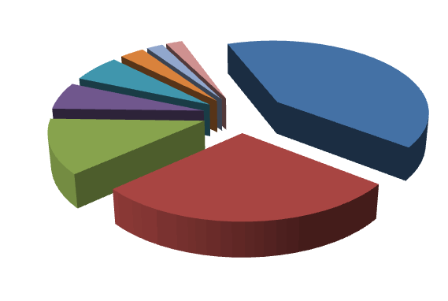
Dorsoduro Shop Breakdown in 2005
Dorsoduro Shop Breakdown in 1970
1970 | Basic Necessity | Closed | Tourist
 | 28% | 3% | 2%
Health 2%
Tourist 2%
2005 | Basic Necessity | Closed | Tourist
 | 5% | 24% | 11%
Health 1%
Closed 3%
Tourist 11%
Clothing 6%
Service 24%
Service 41%
Art 6%
Closed 24%
Basic Necessities 5%
Food Service 12%
Food Service 20%
Clothing 6%
Basic Necessity 28%
Art 9%
Notes:
Tobin

Slide 13
Venetians feel that tourism is a threat to their communities…
Notes:
Tobin

Slide 14
Contro
Tourism
Tourism is like a drop of oil, spreading out from the center of Venice, wiping out the community life.
- 40xVenice Member, 42
Too many tourists, stores are catered towards tourism.
-Retired Venetian, 70
Notes:
Finally, the other most frequently mentioned negative topic was tourism. Almost all of the Venetians we interviewed identified tourism as the source of the problems in Venice whether or not this is true. Tobin

Slide 15
Notes:
Non residents vs dwellings owned Steph

Slide 16
Notes:
Non residents vs dwellings owned Steph

Slide 17
Notes:
Tourists vs residents Steph

Slide 18
Notes:
Tourists vs residents Steph

Slide 19
…and fear that their communities will be wiped out.
Notes:
Steph

Slide 20
Notes:
Population vs tourists Steph

Slide 21
Notes:
Population vs tourists Steph

Slide 22
The Venetian lifestyle is treasured by its inhabitants…
…but residents expressed concerns for the high cost of living and housing.
Venetians feel that tourism is a threat to their communities…
…and fear that their communities will be wiped out.
Notes:
Tourist population vs. venetian population motion chart Steph

Slide 23
Open Ended Questions
How many people commute to Venice each day?
How large a role do commuters play in Venice’s economy?
Are tourism and hotels largely responsible for the housing issue?
What government policies have helped the Venetians? What have hurt them?
What has the government done to stop the population decline?
Notes:
Conclusions

