Slide 1
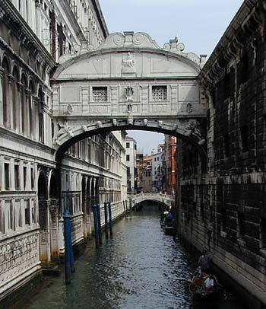
Life in the “City of Water”
An Interactive Qualifying Project Report submitted to the Faculty of
WORCESTER POLYTECHNIC INSTITUTE in partial fulfillment of the requirements for the Degree of Bachelor of Science
Project Center: Venice, Italy
Term: B08
Sponsoring Agency: City of Venice
Project Advisors: Fabio Carrera and Paul Davis
Submitted by:
Stephanie Miskell
Joshua Luther
Tobin McGee
Jenny Lund
Date: October 6, 2008
Email: Ve08-live@wpi.edu
Project Website: http://wikivenice.org/index.php/Living_in_Venice
Notes:
jenny

Slide 2

Determine the factors that effect quality of life
Quality of life includes the physical and physiological aspects of an individuals well being
Mercer’s Human Resource Consulting LLC
Economist
Urban Audit

Slide 3
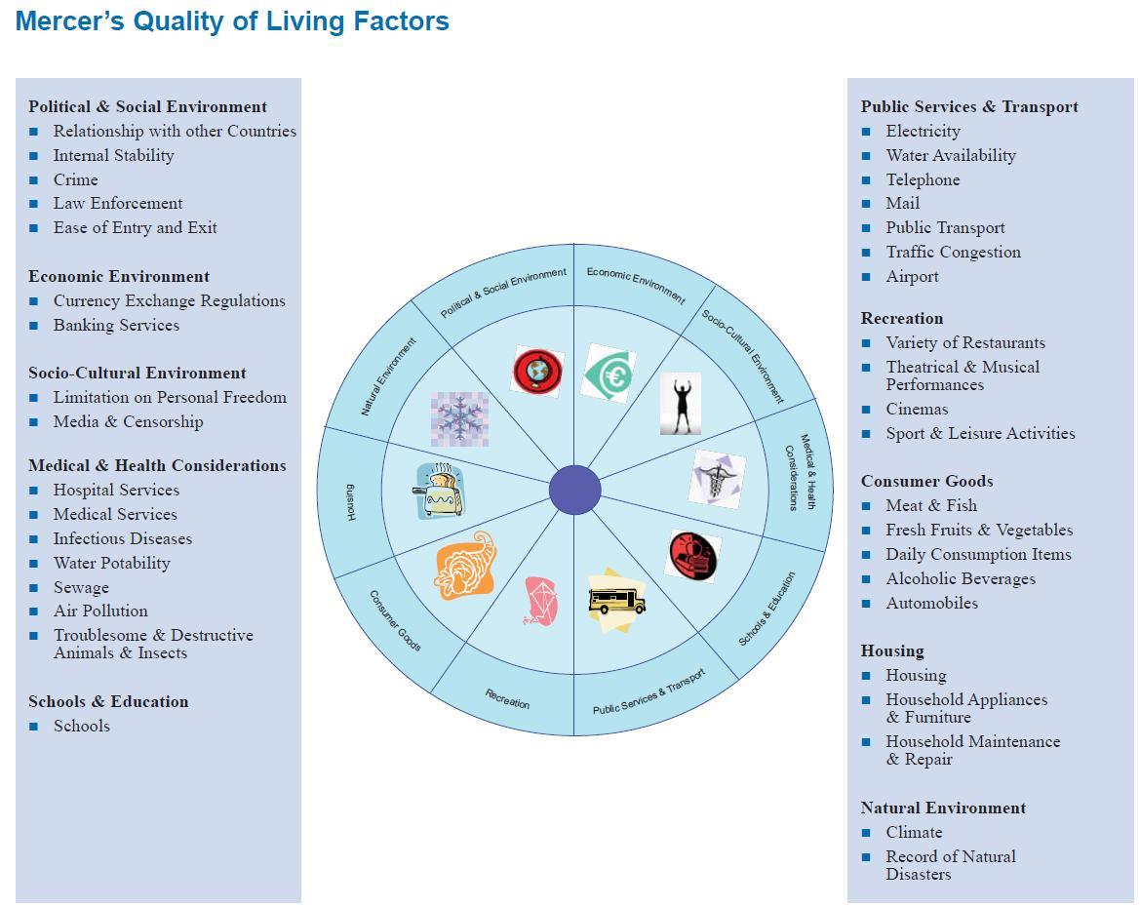
Source:Mercer. (n.d.). Retrieved September 8, 2008, from Defining Quality of Life: www.imercer.com/uploads/common/pdfs/definingqualityofliving.pdf.

Slide 4
The information that has been unearthed relating to quality of life is scattered across various sources and is not available in all languages
The government has implemented various programs to help aid the high cost of living in Venice, but we have yet to find documentation regarding their successes and failures.
Notes:
Jenny

Slide 5
Our mission is to investigate the determining factors of the quality of life of Venetians and to compile our findings into an accessible form for future projects
To analyze all relevant information pertaining to life in Venice
To predict future trends of Venice based on research and collected data
To investigate Venetians' opinions on the quality of life
To explore actions taken by the Venetian government or other key organizations involved
Notes:
Stephanie

Slide 6
Our mission is to investigate the determining factors of the quality of life of Venetians and to compile our findings into an accessible form for future projects
To predict future trends of Venice based on research and collected data
Notes:
Stephanie

Slide 7
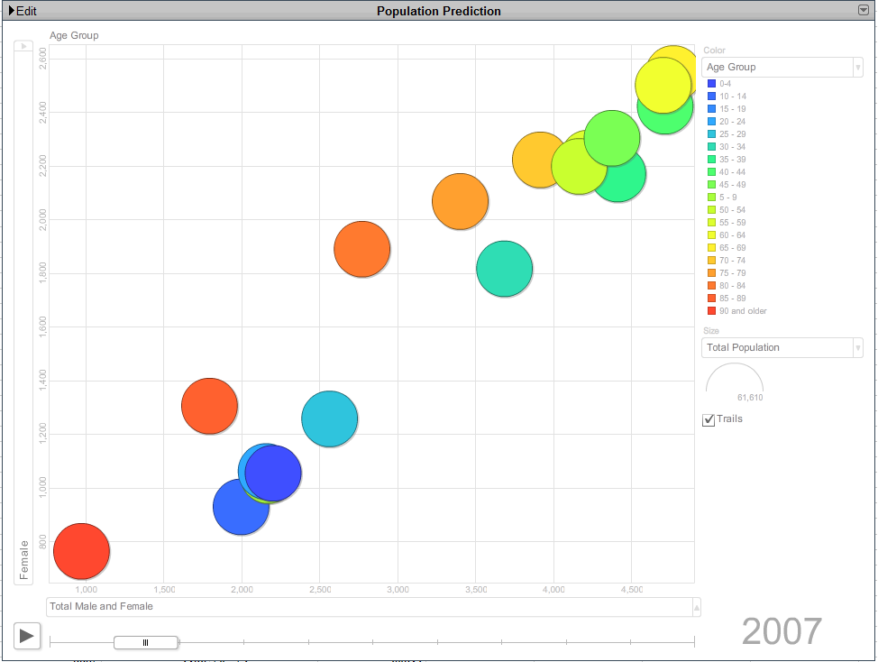
Motion Chart
Notes:
Stephanie

Slide 8
To analyze all relevant information pertaining to life in Venice
Our mission is to investigate the determining factors of the quality of life of Venetians and to compile our findings into an accessible form for future projects
Notes:
Tobin

Slide 9
Quality of Living
Cost of Living
Tourism
Crime
Housing
Economy/Finance
Job Market
Transportation
Public Service
Notes:
Tobin

Slide 10
Notes:
Tobin

Slide 11
Our mission is to investigate the determining factors of the quality of life of Venetians and to compile our findings into an accessible form for future projects
To investigate Venetians' opinions on the quality of life
Notes:
Josh

Slide 12

Survey the local populous to gather a general consensus on quality of life aspects
Determine what quality of life topic they think is most important
Record all interviews on camcorder to avoid an overload of statistics
Notes:
Josh

Slide 13
Our mission is to investigate the determining factors of the quality of life of Venetians and to compile our findings into an accessible form for future projects
To explore actions taken by the Venetian government or other key organizations involved
Notes:
Josh

Slide 14
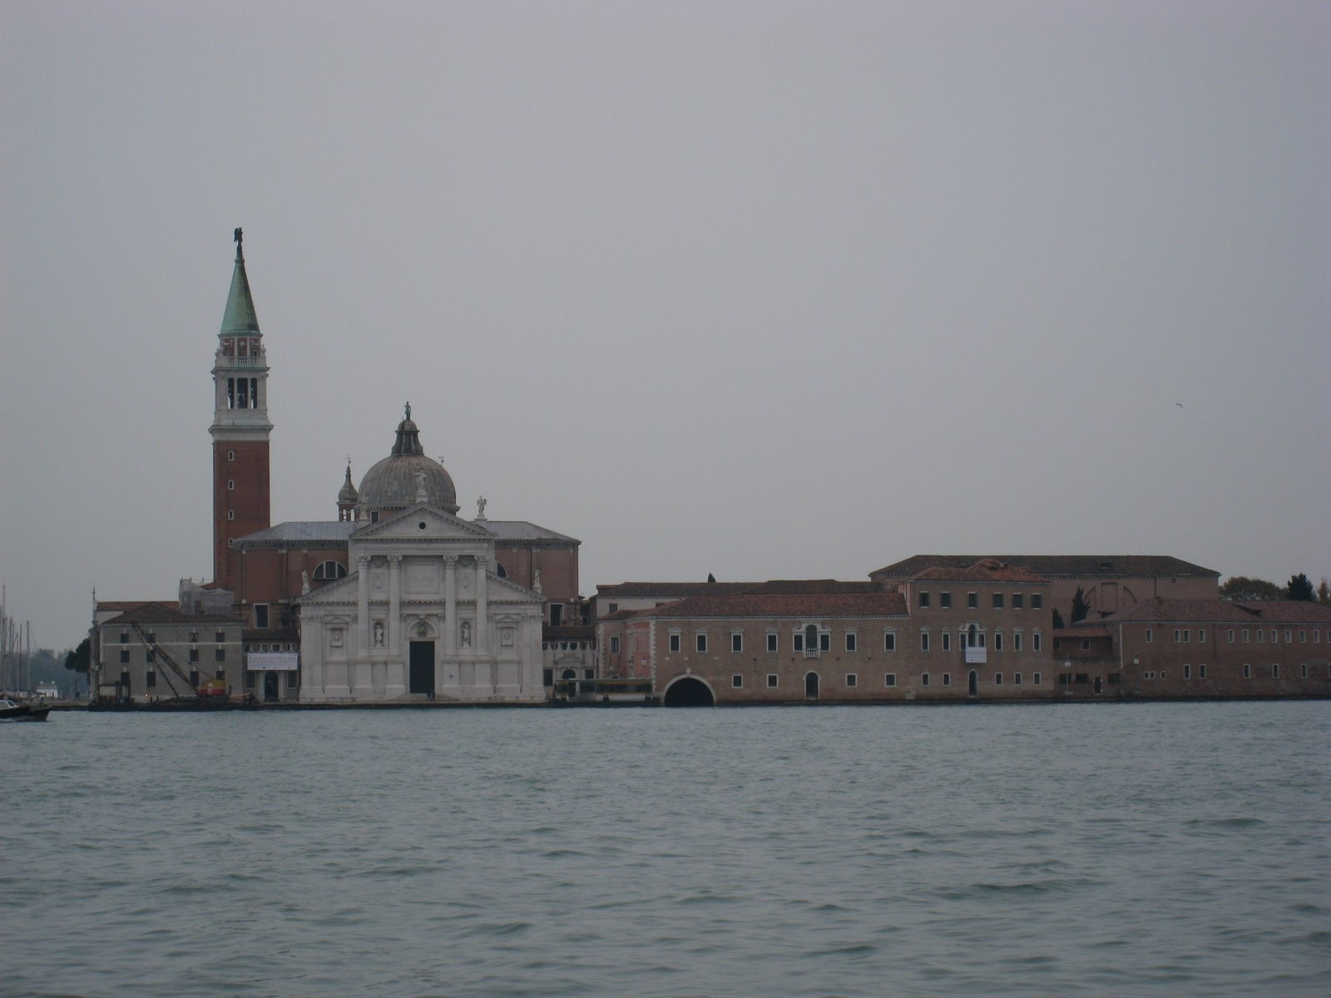
Assess actions taken by Venetian government
Social Programs
Housing
Cost of Living
Retail
Tourism

Slide 15

Translate Citta’ Di Venezia Website and other Italian websites
Information specifically about the Historical Center

Slide 16
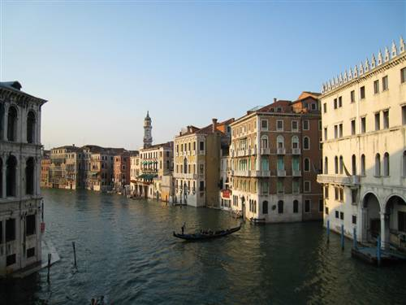
Compile Quality of Life Data
Continually update Living in Venice wiki page
Revise and update proposal
Create more “killer graphics” as data is collected
Review previously recorded IQP interview

Slide 17


